Slide 1


Steam Reviews Data Analysis using Tableau
Azim Pathan, Walter Giron, Clever Lemus, Yuner Paredes, Sipan Kouchian
Professor Jongwook Woo | CIS 4560 TEAM 1

Slide 2
Main Menu (Table of Contents)
Introduction
• Dataset Details and Overview
Methodology
• Cluster Specification
• Workflow Chart
Data Cleaning & Processing
Data Analysis
Propose Business Strategies via Analysis
• Hadoop
• Tableau Prep
• Tableau Desktop / Prep
Conclusion
• What was learned

Slide 3
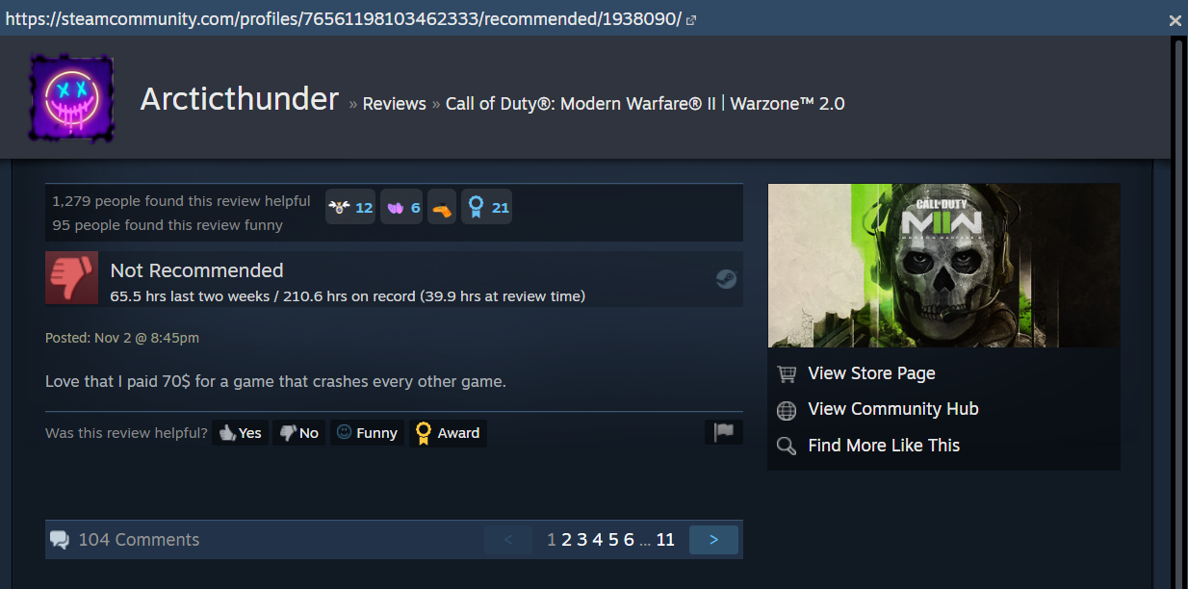

Introduction: What is our Dataset?
Steam Reviews Dataset 2021 - Marko M.
Dataset is from Kaggle | <!Dataset Link>
Temporal Coverage: 2013 -> 2021
Total Dataset Size: 8.17GB
Total Rows: Almost 50 Million
Total Columns: 23
Total Games: 300+

Slide 4
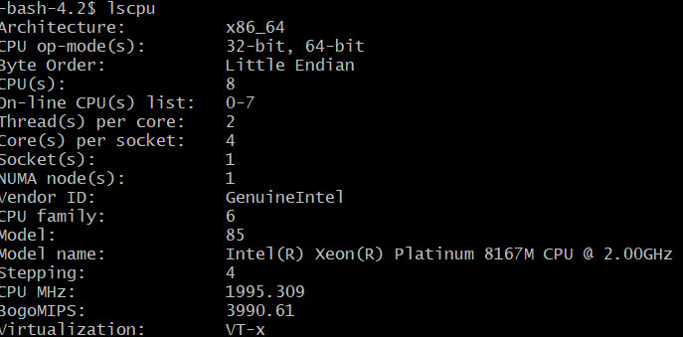
Hardware Specifications
Cluster Version: Hadoop 3.1.2
Command: hadoop version
Number of Nodes: 3
Command: yarn node –list all
Memory Size: 58GB
Command: free -h
CPU Speed: Intel Xeon Platinum 8167M @ 2.0 Ghz
Command: lscpu

Slide 5
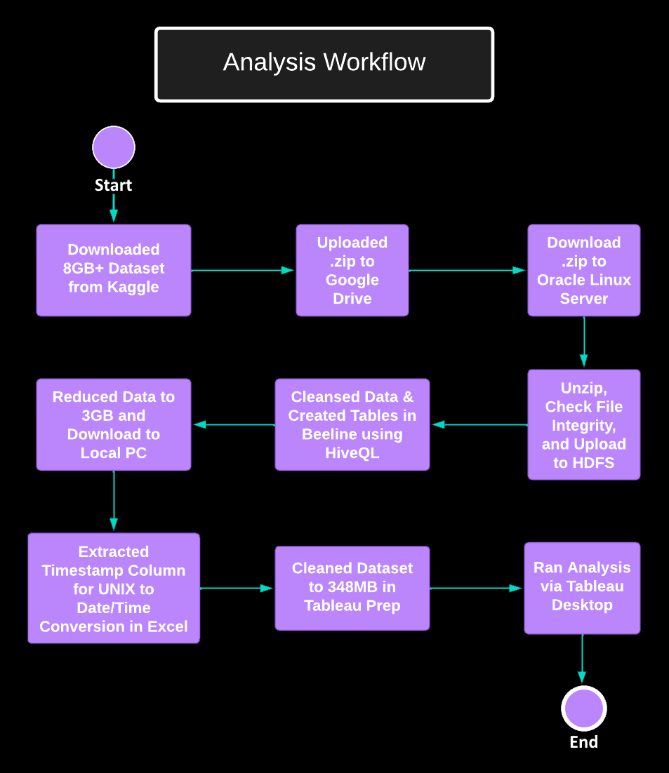
What did we do with it?
A lot of stuff
Uploaded Files to Oracle Linux
Cleaned and Reduced Dataset from 8GB (Origin)-> 3GB (MapReduce)-> 348MB (Tableau Prep)
Ran Geo-Spatial, Time-Series, Basic Natural Language Processing, Analysis

Slide 6

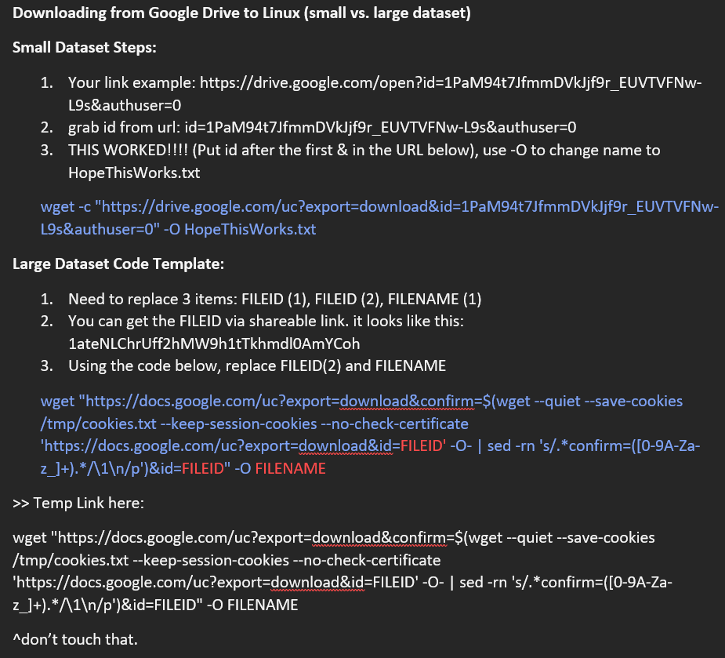
Methodology - How did we do it?
These are our notes.

Slide 7
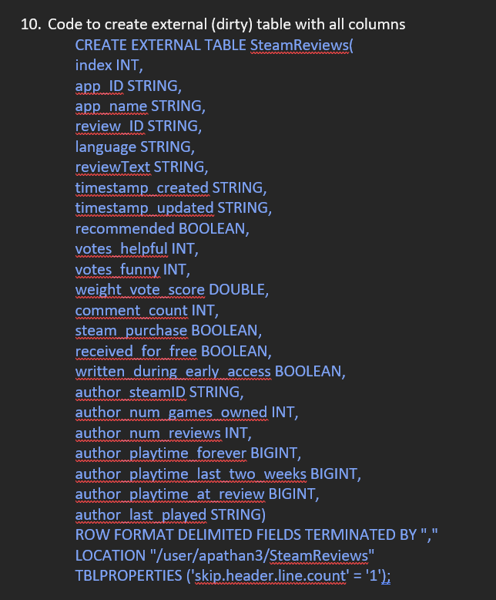
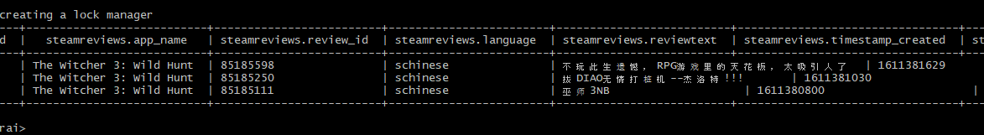
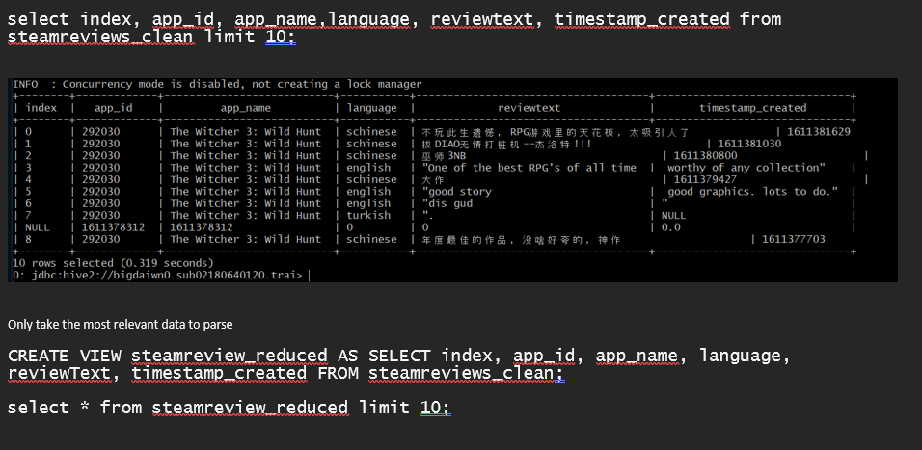
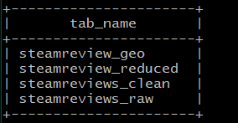
Creating Tables using Beeline
It’s actually working…! For now.

Slide 8
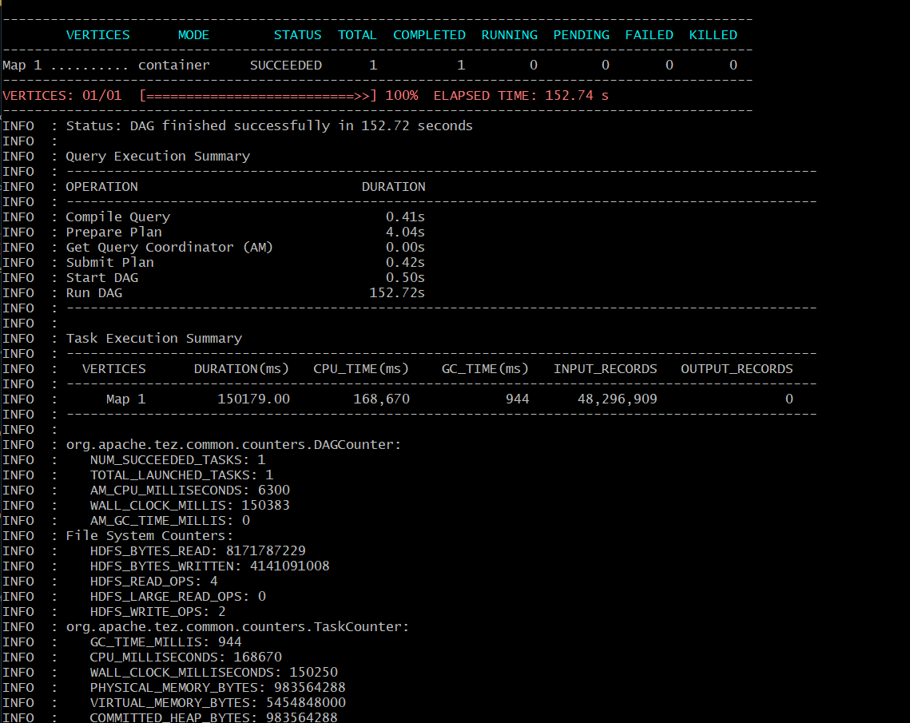

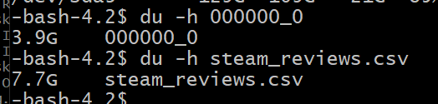
MapReduce Time!
Or Else…

Slide 9

Challenges Along The Way… and Some Pizza.
The reviewText column data was completely messed up.
Or so we thought.
Why.

Slide 10
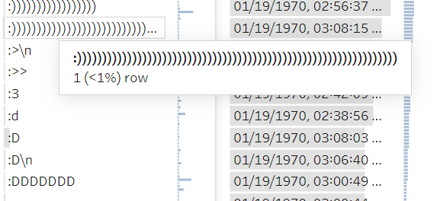

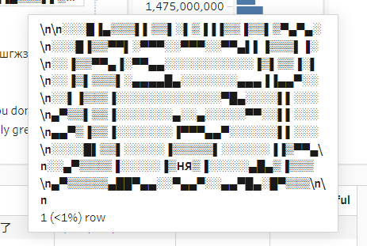
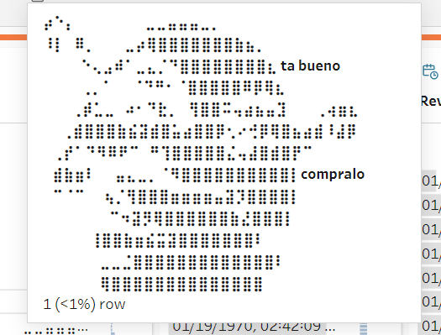

But then we realized… it wasn’t NULL after all.
…I ain’t the sharpest tool in the shed…

Slide 11
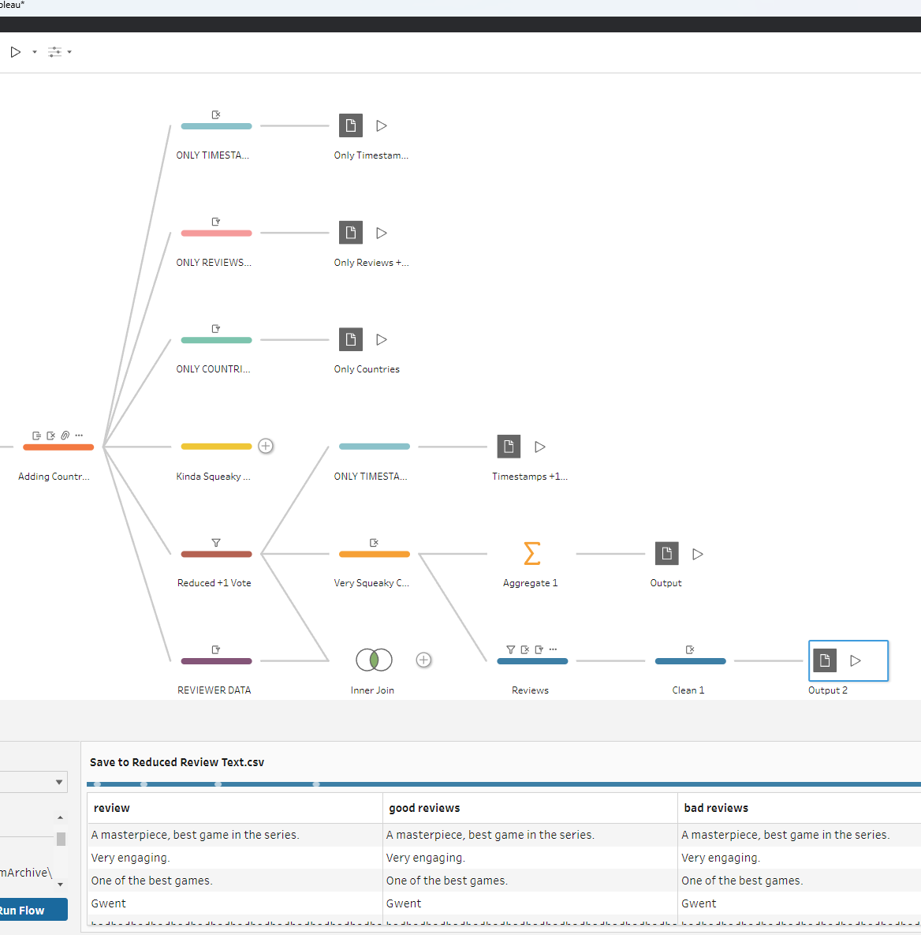
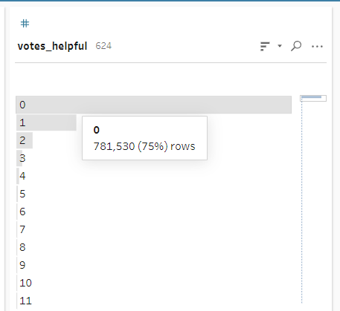
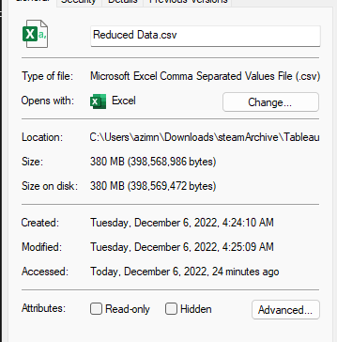
Cleaning & Reducing with Tableau Prep
Created Several Clean Steps:
Timestamps
Country
Filtered Spam / Redundant Review Data
Helpful Votes > 1
Removed More Than Half of the Data

Slide 12
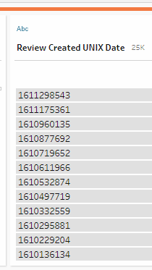
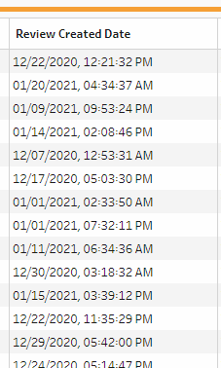
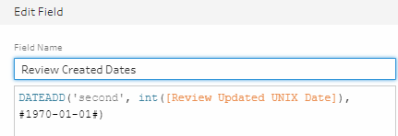
Unix Timestamp Conversion Process

Slide 13
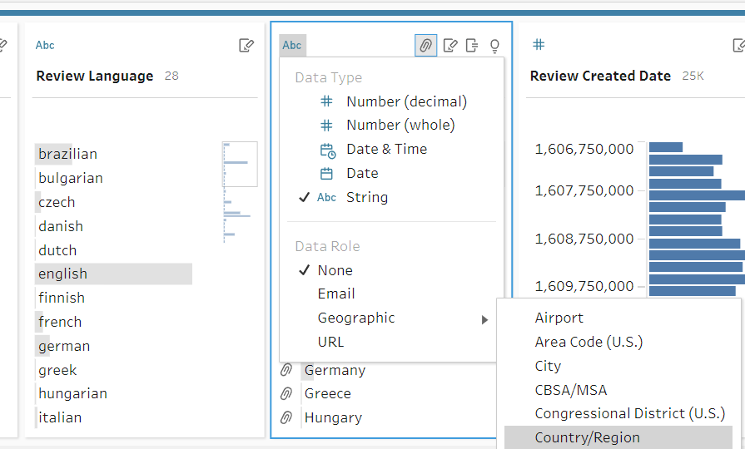
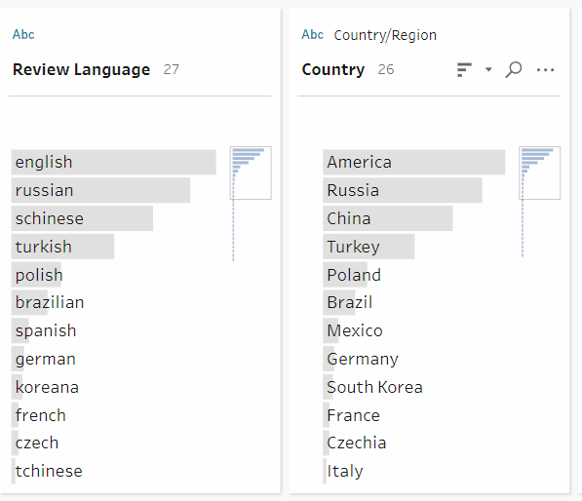
Derived Country Variable
Not Ideal…
But nonetheless served our purpose.
Manually Convert Language -> (Assumed) Country Variable

Slide 14
Why is this Useful? Look closely.
Businesses can analyze the review data to:
Analyze the Market
Better Understand Competitors
Get Feedback from Users and Improve Products
Streamline the Customer Experience
Create More Effective Solutions
Note the keywords in the text above:
Analyze, Understand, Improve, Streamline, and Create Effective Solutions
This is an example of how Artificial Intelligence (AI) uses Natural Language Processing to extract and define relevant text to produce useful results. We will discuss more later.

Slide 15
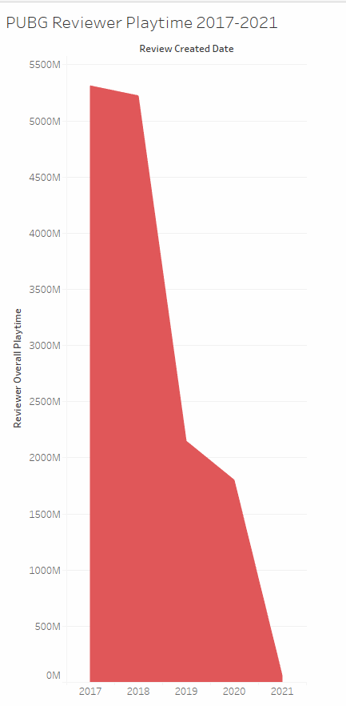
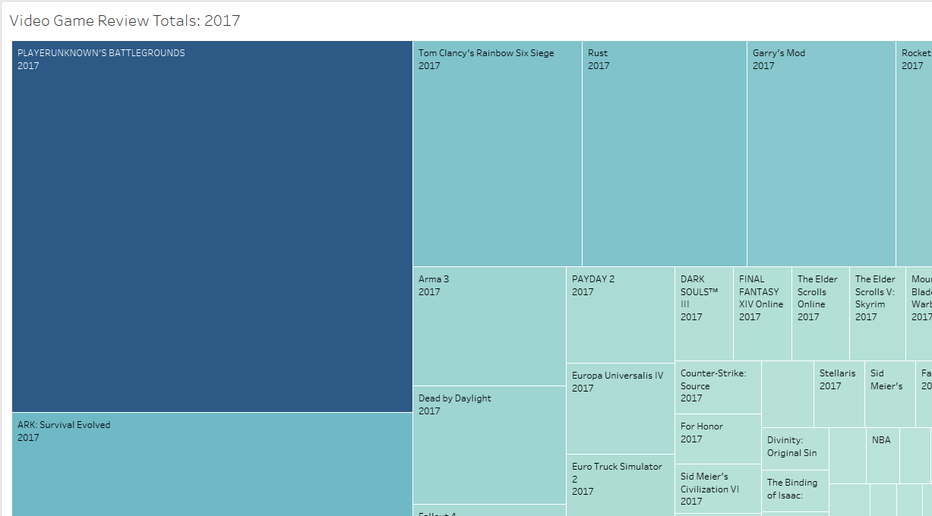
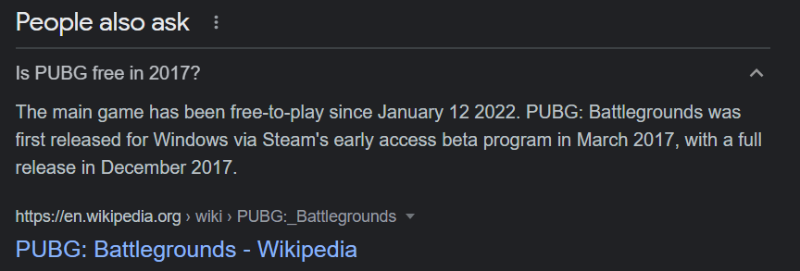

Video Game With the Highest Reviews in 2017: PUBG

Slide 16
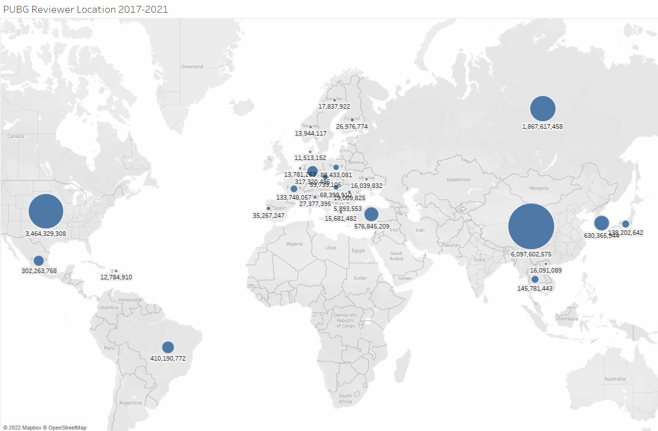
PUBG Reviewer’s Assumed Location: Aggregate Reviews 17-21

Slide 17
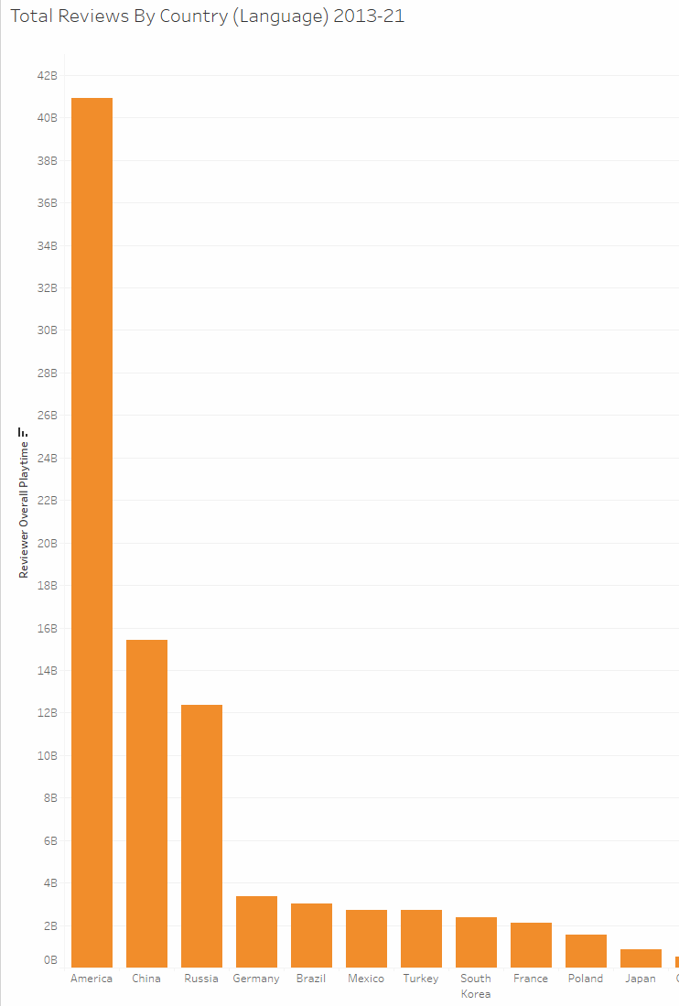
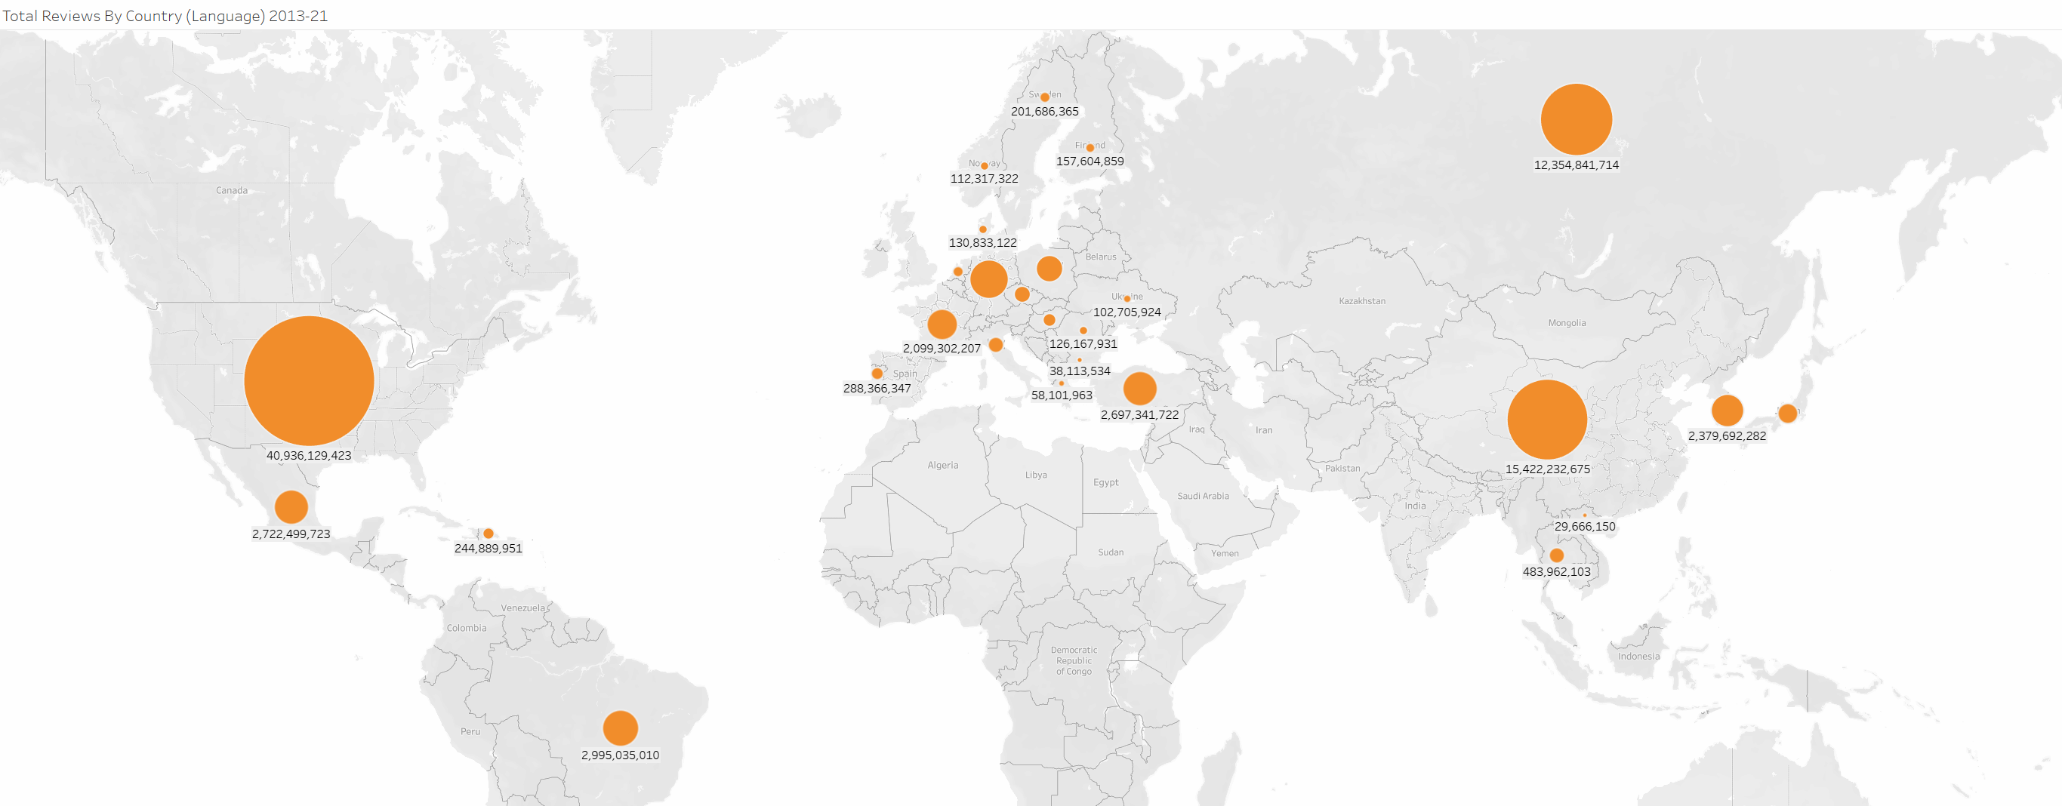
Geo-Spatial Visualization | Entire Dataset
Total Reviews By Country (Language) 2013-21 Bar Graph vs. Geospatial Visualization

Slide 18
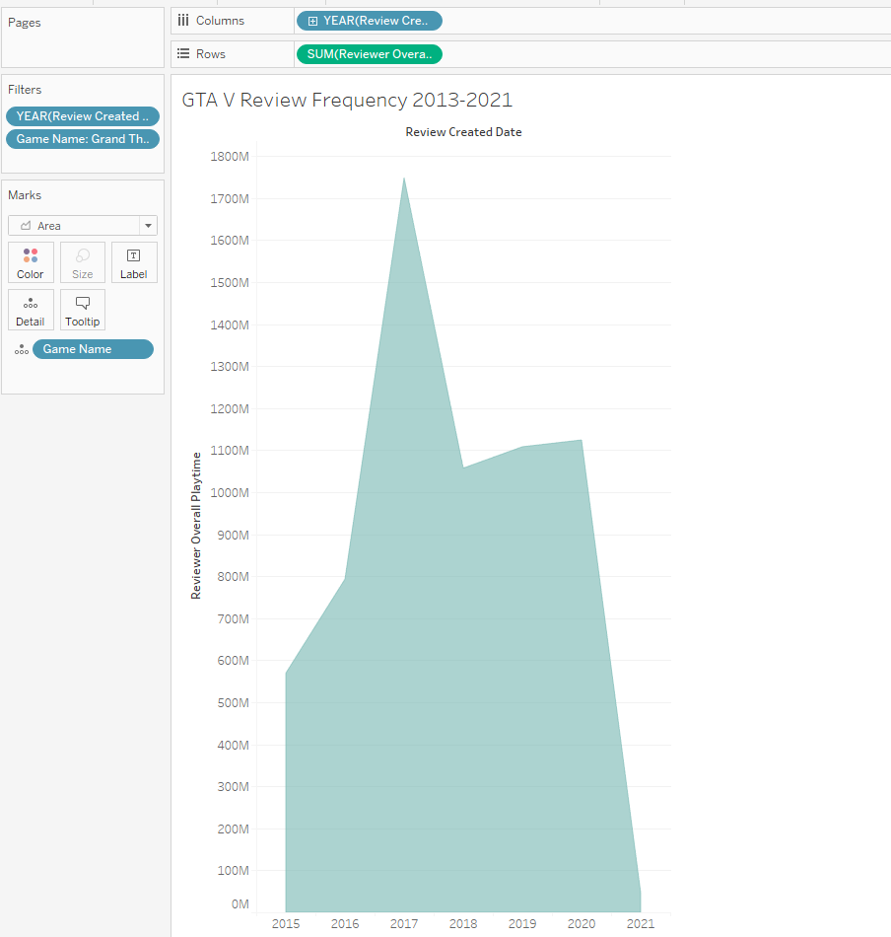
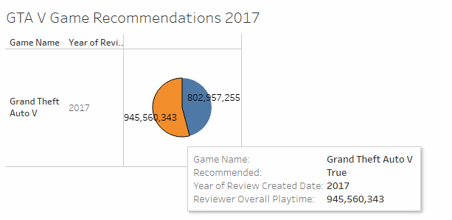
Temporal Analysis From a Business Perspective: Grand Theft Auto V
Statistical Assumption:
From the data we can infer that GTAV had an explosive review count in 2017.
Potentially Misleading:
From a business perspective, this does not necessarily mean that Rockstar Games™ can assume the game was doing well.
Reviews could also indicate negative or positive feedback.

Slide 19
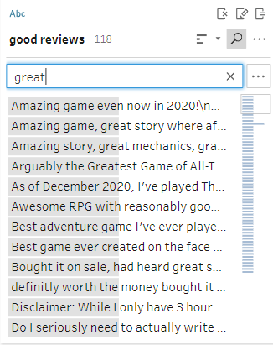
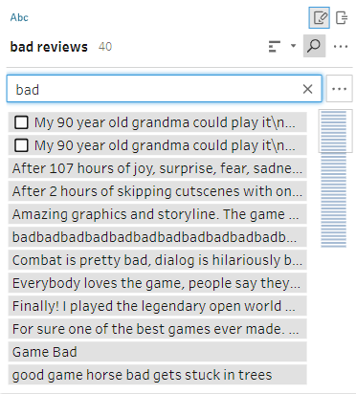
Natural Language Processing
As mentioned earlier, we can use key words to analyze review data and understand more about what game developers can improve on
Good Reviews “Positive” Keywords
Yes, Good, Great, Amazing
Bad Reviews Negative Keywords
Bad, Awful, No

Slide 20
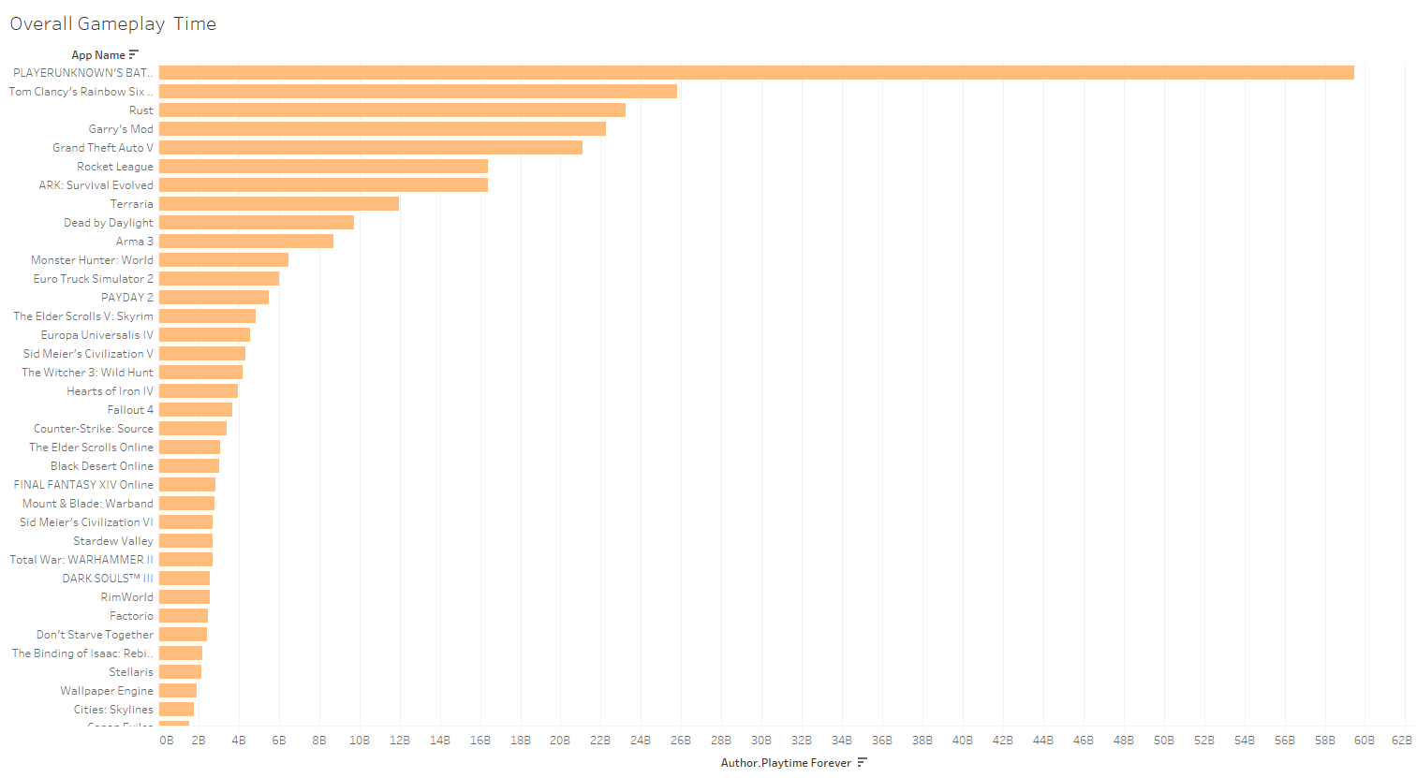
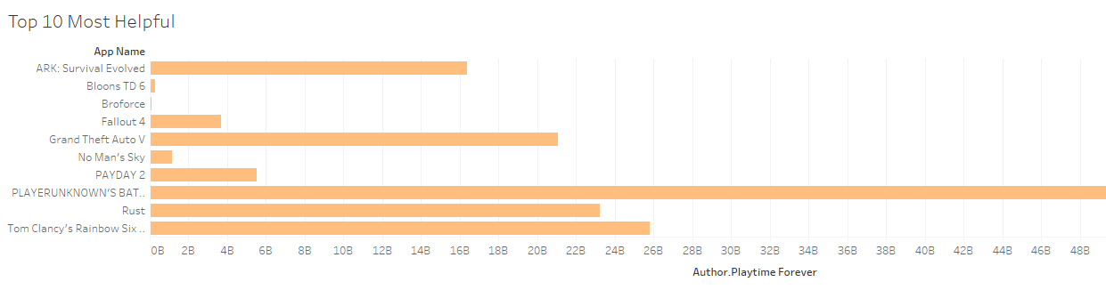
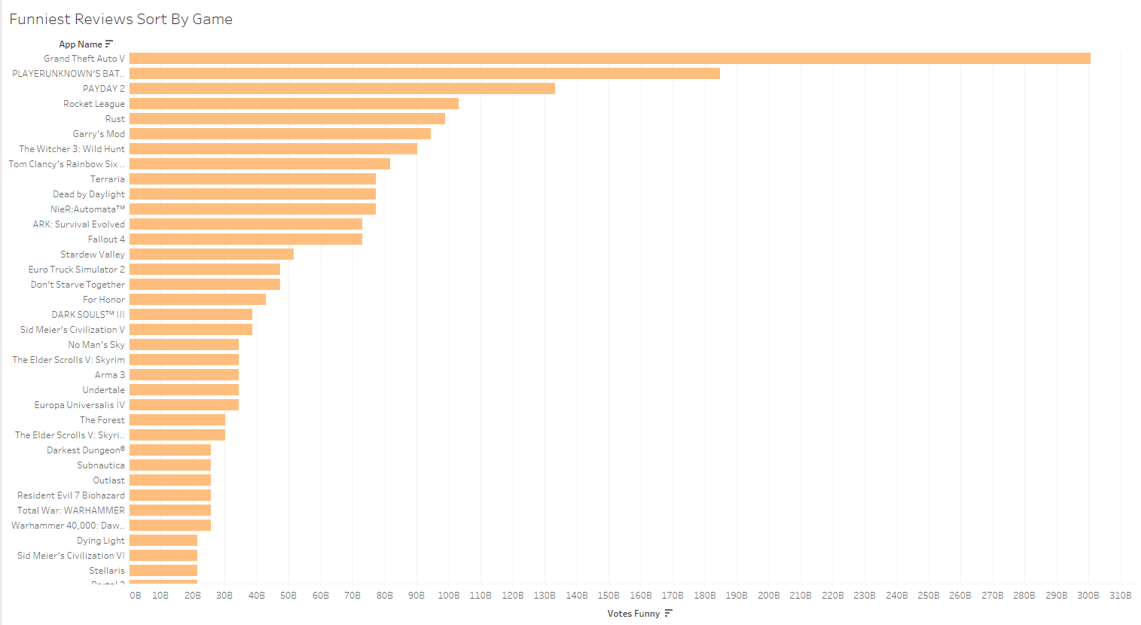
Other Analysis
Which game has the funniest reviews overall?
GTAV.
Highest Gameplay Time?
PUBG.
Highest Gameplay Time:
Funniest Reviews:
Top 10 Most Helpful Comments:

Slide 21
Game Over. (This is the Conclusion)
So, what did we learn?
Hadoop (HDFS/MapReduce/Yarn) can be used to analyze massive amounts of data without burning your computer.
Tableau, Excel, and other analysis software can drastically help improve analysis quality and beautifully visualize data.
Businesses can use Big Data analytics to analyze, understand, improve, streamline, and create effective solutions.
Big Data analytics is cool.

Slide 22
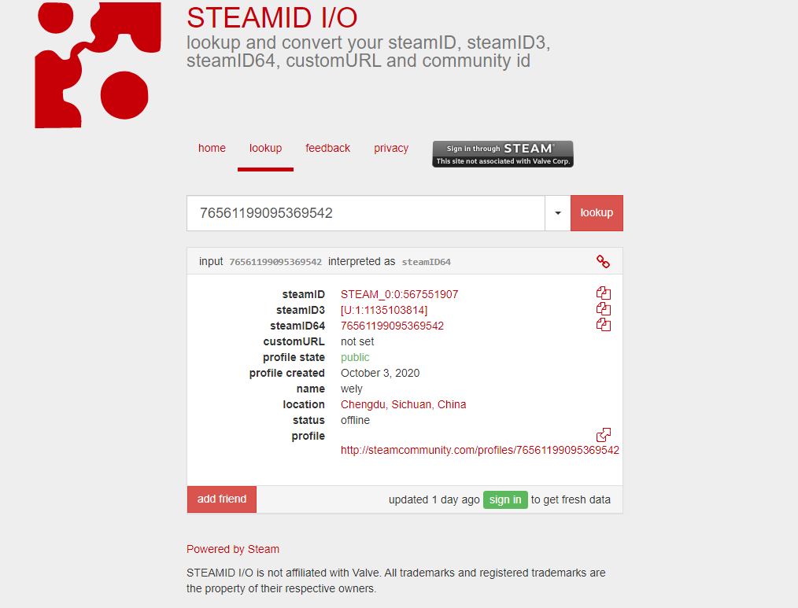

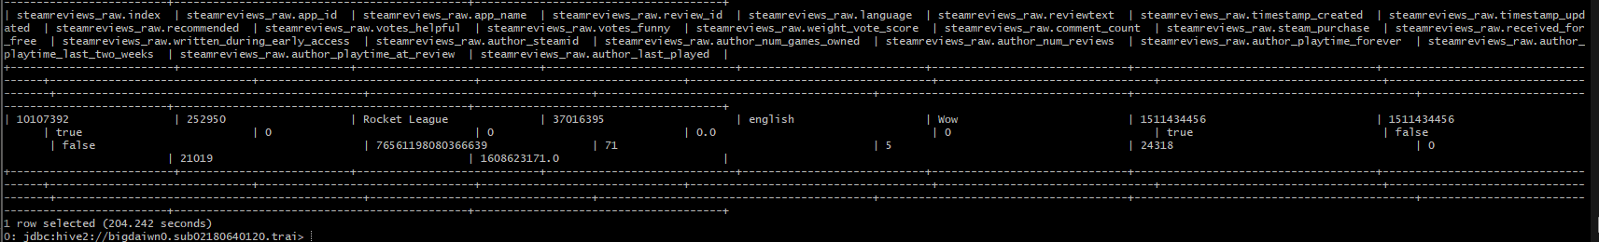
Something Interesting…

Slide 23
GitHub Repository Link
Click Me!

